Slide 1
13 Fun Tips for Trainers
(In Twelve Minutes)
Which will be damn near impossible for…
Michelle Lewis, President ROCATD

Slide 2
Notes:
Sheets filled out; Instructions for the game.

Slide 3
Exercise Instructions
Specific
Observable
Sequential
*Plant Yourself

Slide 4
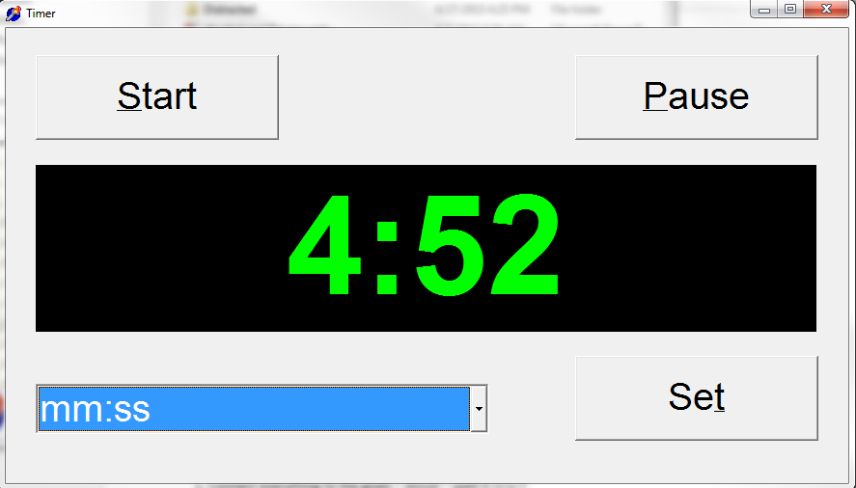
Use a Timer

Slide 5
Follow-Up & Transfer
President@rocatd.org
Email me between September 15th and October 15th with at least 2 tips that you have used in your training and I will send you my timer!

Slide 6
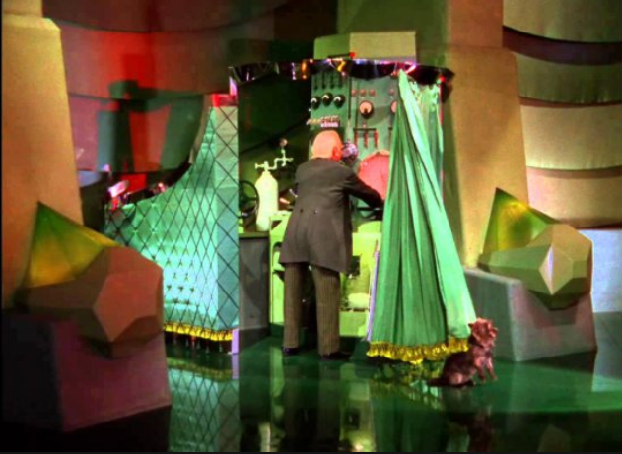
Behind the Curtain

Slide 7
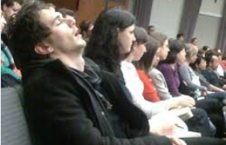
Lunch – Not For the Faint of Heart

Slide 8
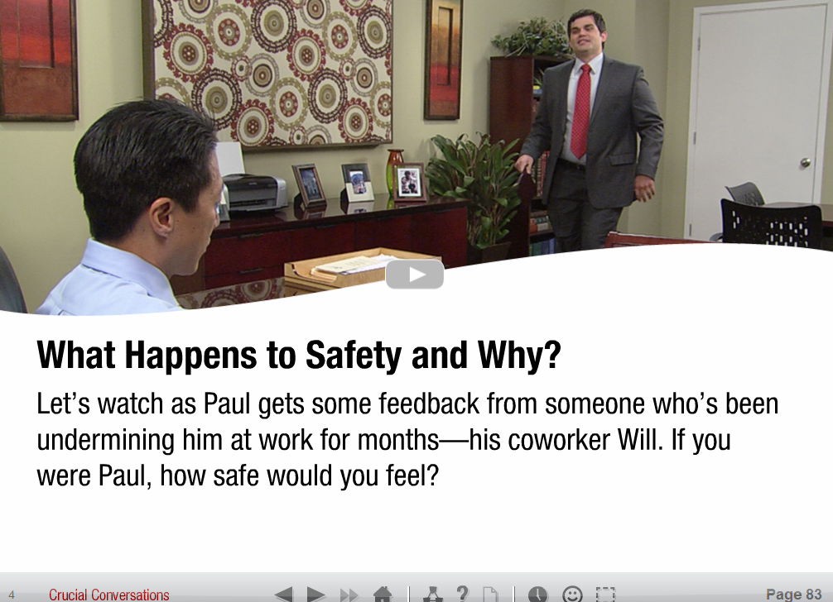
Introducing a Video
Introduce characters
Describe setting/relationship of characters if necessary
Explain specifically for what they should be looking
Same question in debrief as in set-up

Slide 9
Questions

Slide 10
Time to Think

Slide 11
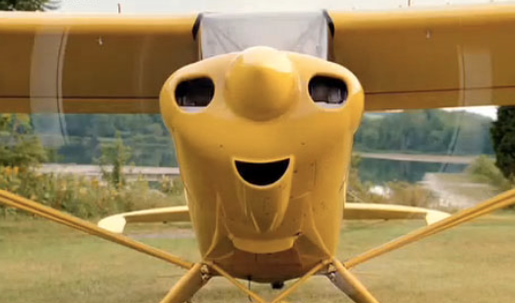
Meaning First and Then Details - ALWAYS

Slide 12
Attention

Slide 13
Just a Rumor

Slide 14
Ecology
Random aging sentences
Love them!
Notes:
Relations and interactions between organisms and their environments. John Medina (molecular biologist)

Slide 15
Always Wrap Up – Always!
Lasting impression

